Slide 1
Music Reactive RGB LED Strip using arduino nano​
Biswajit Sarkar
2101AI11
Arduino mini Project(CS209-CS210)

Slide 2
Overview
Light up your new year parties and impress all your friends with these amazing music reactive multicolor LED lights that response and change their colors on every loud beat. These lights are nothing but simple RGB LED strips connected to arduino - the brain of this project. LED strips mean that you can mount them anywhere in your home and even outdoors. The main purpose of this project was to use it in parties but you can also use it for daily purpose for making your music more interesting! Whether you mount in on your entrance door, around your sofa, your LED TV, on your computer desk or walls, that's up to you. The uses of this thing are endless! The only condition is that you have to have an audio output device near your lights to feed them with audio signals which can be processed and reacted upon.
Based on this idea, I tried to make a cheap sound reactive led strip .

Slide 3
Components required
Sound Sensor
WS2812B Addressable LED Strip(5V)
Arduino Nano
Bread Board
Jumper Wires
Power Bank
USB Cables

Slide 4
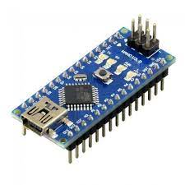
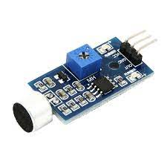
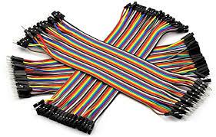
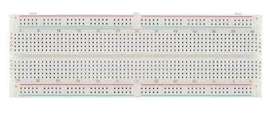
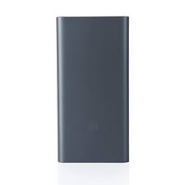
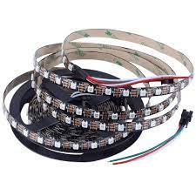
Sound Sensor
Arduino nano
Jumper Wires
BreadBoard
Power Bank
WS2812B RGB LED STRIP

Slide 5
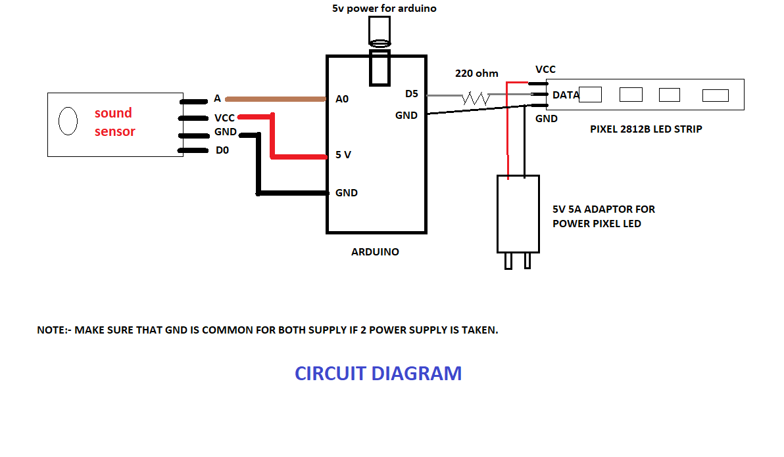
Circuit diagram

Slide 6
Pins table
Arduino | LED STRIP
D5 | DATA
GND | GND
Arduino | Sound Sensor
A0 | OUT
5V | VCC
GND | GND
LED STRIP | Power Bank/Adapter
5V | +5V(DC)
GND | GND

Slide 7
1.Arduino Nano
An Arduino Nano is perfect for this project because it can handle the load of the LED strip, you can write multiple programs depending on what particular behavior you would like to see from your LEDs and besides the standard General Purpose Input/Output (GPIO) pins.
2.Sound Sensor
The basic idea behind this component is that it picks up sounds that cross a certain decibel level. This module has a which allows the user to fine tune the sensitivity of the microphone, so that way you can have the microphone register very subtle quiet noises or you can decrease the sensitivity to the point where it only listens for louder than average sounds loud claps, shouts, etc.
3.WS2812B LED STRIP
WS2812B LEDs have an IC built into the LED which allows one-wire interface communication. This means that you can use one pin on your controller to power several LED's. There are 3 pins in the LED strips: the power pin (+ 5V), the ground pin (GND), and the data pin (DIN and DOUT).

Slide 8
working
As told above, this project uses an sound sensor for taking the analog audio input and then it convert into digital , and it is connected to arduino which processing it and then giving an output through it's digital pins to the LED strip controller circuit which then drives the strips. It uses a 5v power supply to power for the strip .
And then the led lights blinks as per music beats…

Slide 9
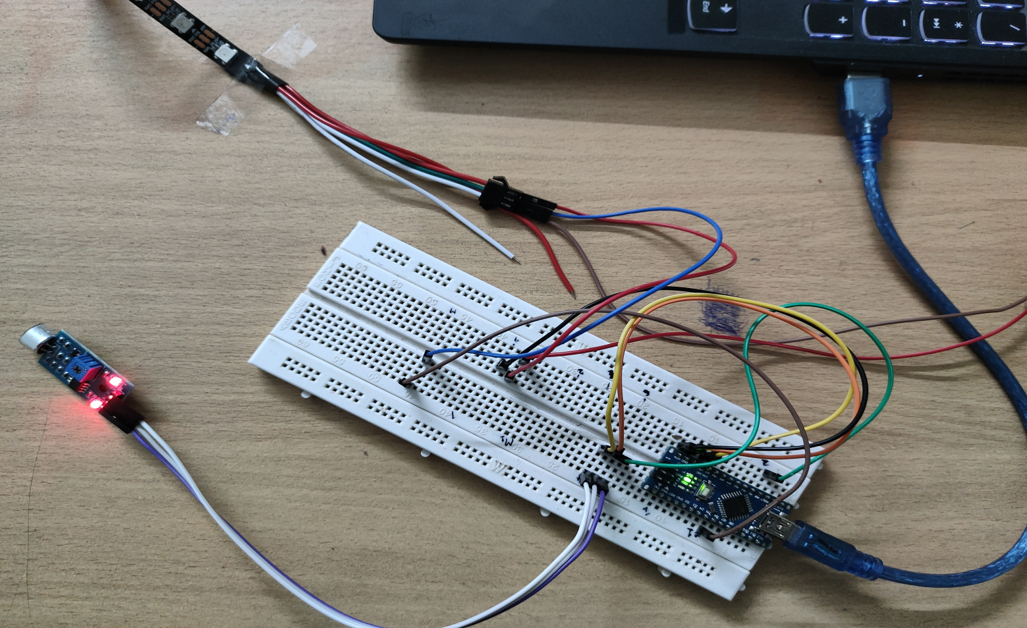
Circuit

Slide 10
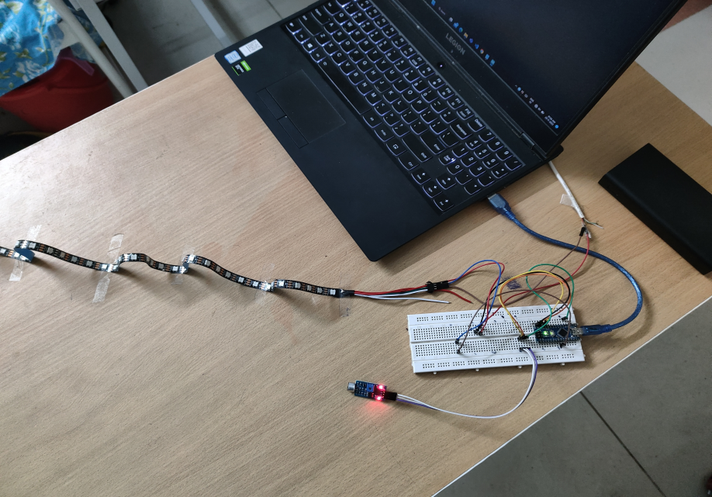
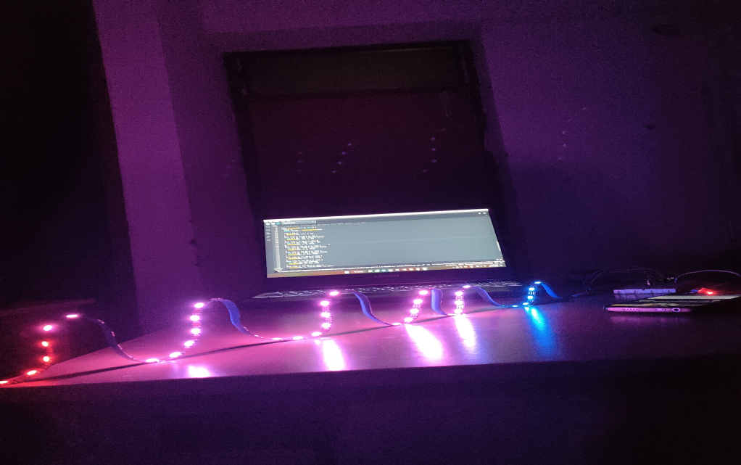
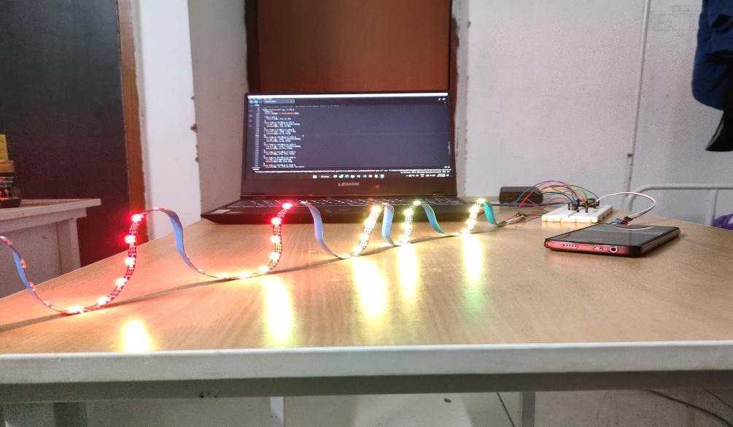
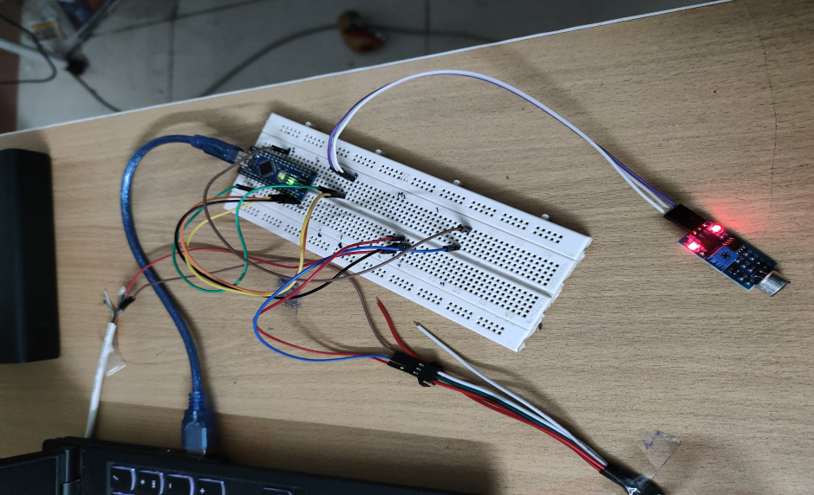
Project images

Slide 11
References:-
https://create.arduino.cc/projecthub/MaheshBHISHNOI/how-to-make-diy-music-reactive-rgb-led-strip-ws2812b-0dbaf4
https://www.instructables.com/Sound-Reactive-LED-strip/#:~:text=This%20module%20has%20a%20dial,average%20sounds%20loud%20claps%2C%20shouts%2C
https://www.youtube.com/watch?v=NeTVxjG42tk&t=157s
https://create.arduino.cc/projecthub/diyprojectslab/diy-music-relative-rgb-strip-light-5ca700?ref=similar&ref_id=376065&offset=1

Slide 12
Thank you

